Slide 1
Interpretation of the Spatial Pooler SDR Reconstruction
Information Technology Course Module Software Engineering by Damir Dobric / Andreas Pech
ML 23/24-04 Implement the Spatial Pooler SDR Reconstruction
Subham Singh [1506413] Email: subham.singh@stud.fra-uas.de
Amit Maity[1502808] Email: amit.maity@stud.fra-uas.de
Rubi Kiran[1504617] Email: rubi.kiran@stud.fra-uas.de

Slide 2

Content
Problem Statement
Introduction
Methods
Experiment
Result
Future Development

Slide 3
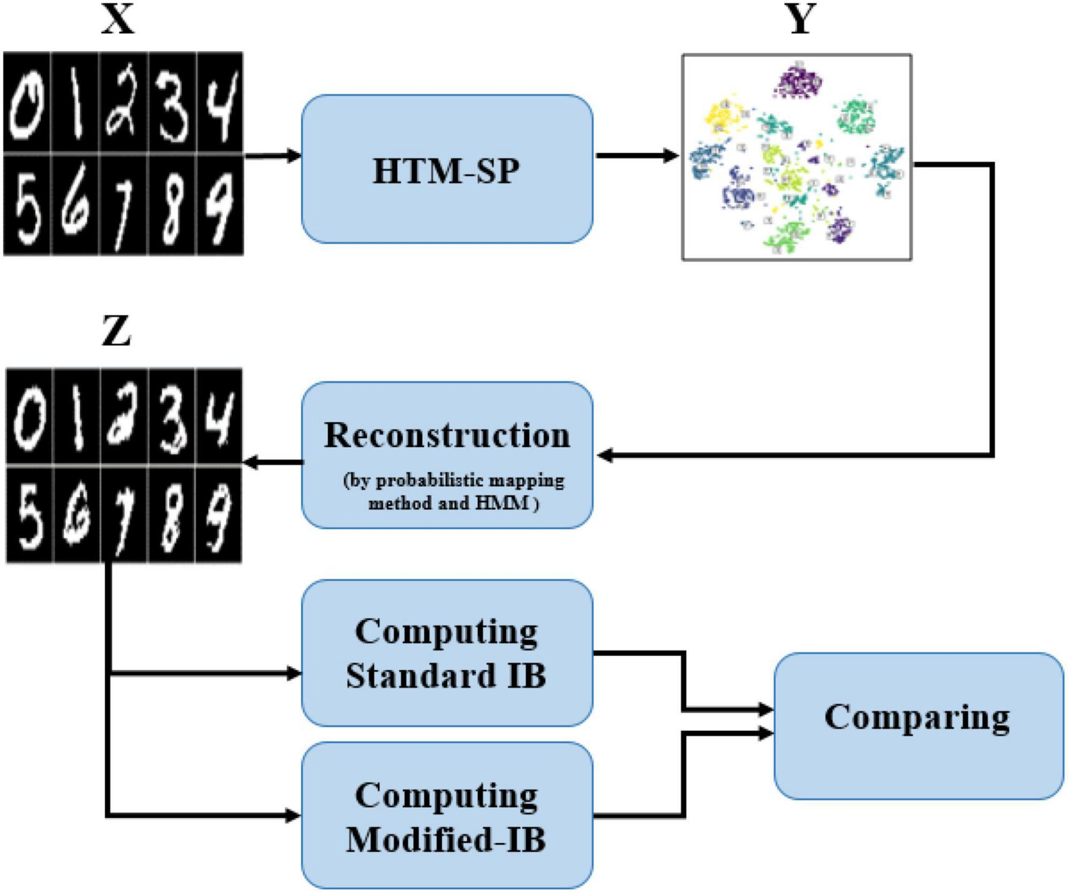
Problem Statement
ML 23/24-04 Implement the Spatial Pooler SDR Reconstruction
Design an experiment to investigate and visualize the reconstruction process performed by the Reconstruct() method in the NeocortexAPI's SpatialPooler class.

Slide 4
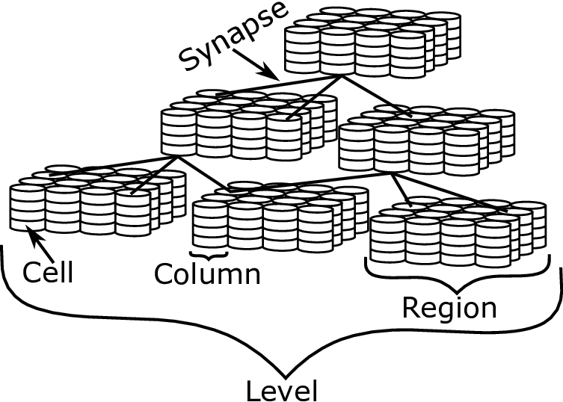
Introduction
Hierarchical Temporal Memory (HTM) is a fascinating machine learning technique inspired by the neocortex. It’s designed to learn and predict sequences, aiming to generate generalized representations for similar inputs.
Sparse Distributed Representations (SDRs): These are fundamental in Hierarchical Temporal Memory (HTM) systems. The HTM spatial pooler (SP).

Slide 5
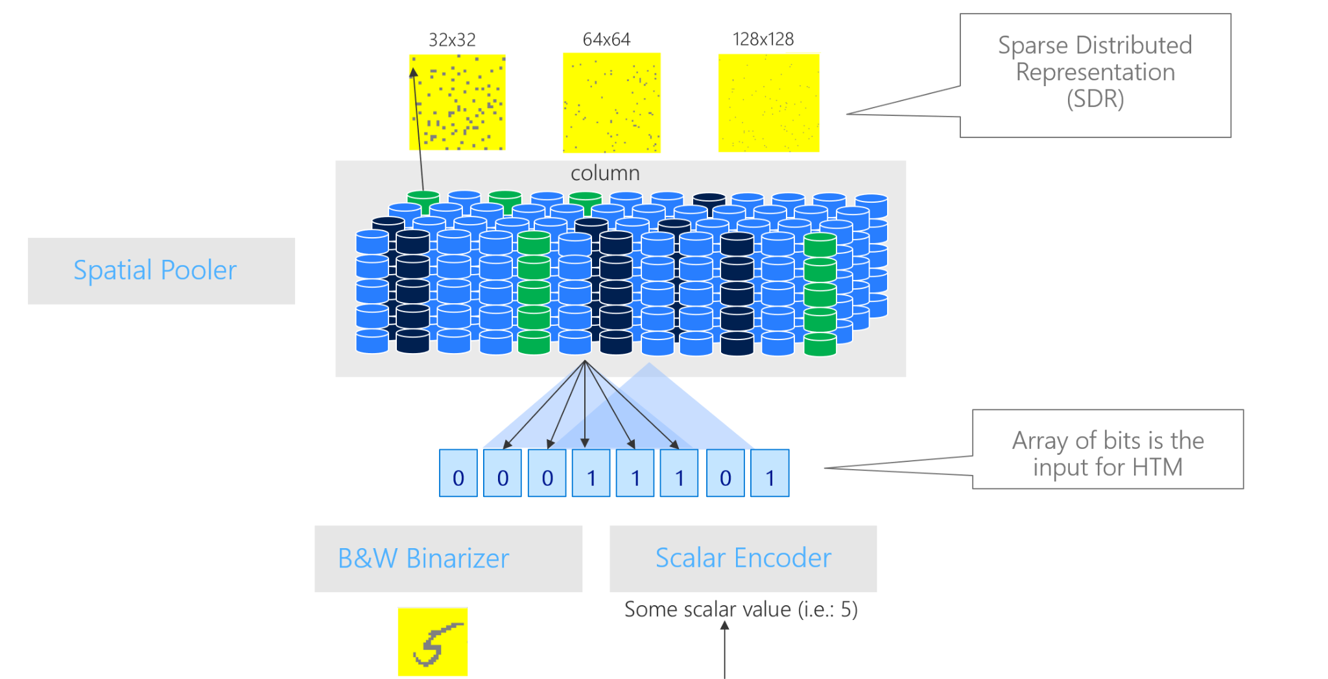
Methods
Encoder
Scalar encoder
The Scalar Encoder plays a crucial role in the Spatial Pooler (SP), drawing inspiration from the neocortex. Its main purpose is to transform scalar input values into Sparse Distributed Representations (SDRs). To achieve this, the Scalar Encoder follows specific rules, including competitive Hebbian learning and homeostatic excitability control.
Image Binarizer
The Image Binarizer is a preprocessing step used to convert continuous-valued pixel intensities in an image into binary values (usually 0 or 1). It simplifies the image representation by thresholding the pixel values.

Slide 6
Spatial Pooler
Sparse Distributed Representations
The Spatial Pooler converts input patterns into Sparse Distributed Representations (SDRs) in an ongoing, online manner. The HTM temporal memory learns temporal sequences from these SDRs and generates predictions for future inputs. The spatial pooler organizes data in the spatial dimension by creating pools or clusters. During the spatial pooler’s learning process, each input pattern is compared to a database of other patterns.
Sparse distributed representations (SDRs) are a type of data encoding method used in various fields, including neuroscience, artificial intelligence, and machine learning. In SDRs, information is represented by activating a small percentage of elements in a large vector or array, while the rest remain inactive or "sparse."

Slide 7
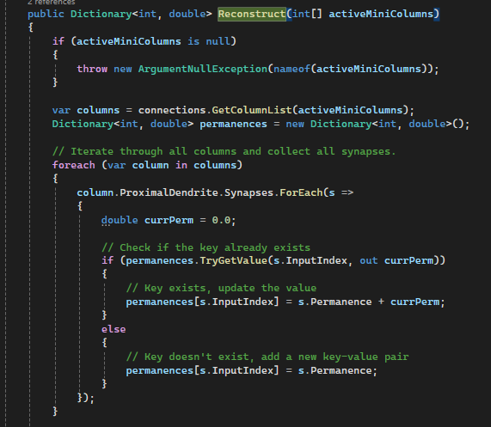
Reconstruction
Its is a method within the spatial pooler class. When this method is invoked, it produces a dictionary where the input indices serve as keys, and their corresponding aggregated permanence values act as values. Essentially, this dictionary represents the reconstructed input pattern based on the active columns in the spatial pooler.

Slide 8
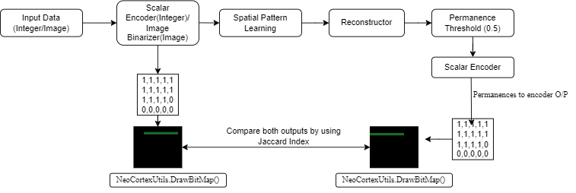
Experiment

Slide 9
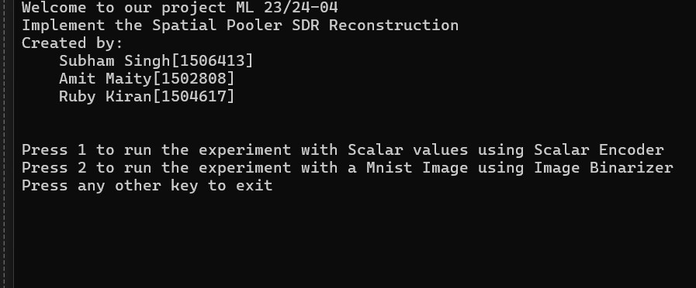
User Interface (UI)
A simple user interface using switch case to implement both parts of the experiment together.

Slide 10
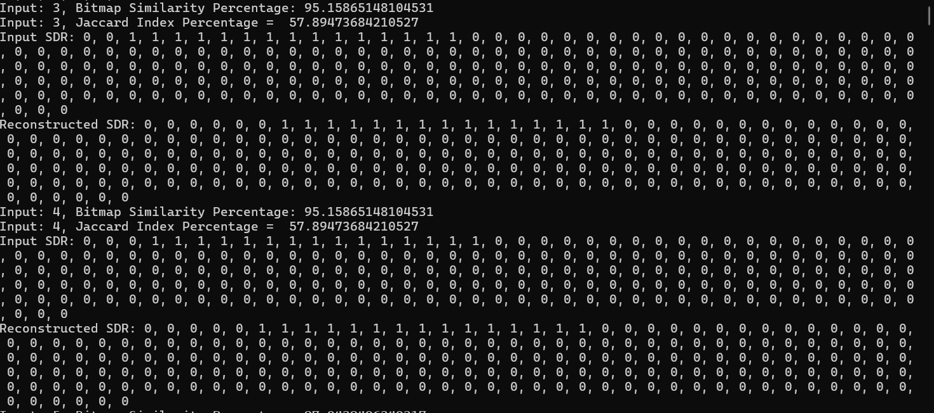
Results
Case 1 : SDR reconstruction for Scalar Values: The analysis resulted in computing Sparse Distributed Representations (SDRs) for random integer values (100 to 1000), followed by input reconstruction from the SDRs. Comparison of input and reconstructed bitmaps using BitmapComparator revealed visual similarity. Further analysis involved calculating the Jaccard index and bitmap similarity percentage for additional insights.

Slide 11
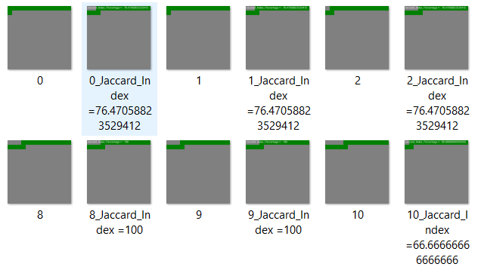
Results
Case -1 :
Upon creating bitmaps for the input SDR and the Reconstructed SDR, it was observed that we were able to achieve a similarity of 100 percent with average similarity of 82% based on the image shown.

Slide 12
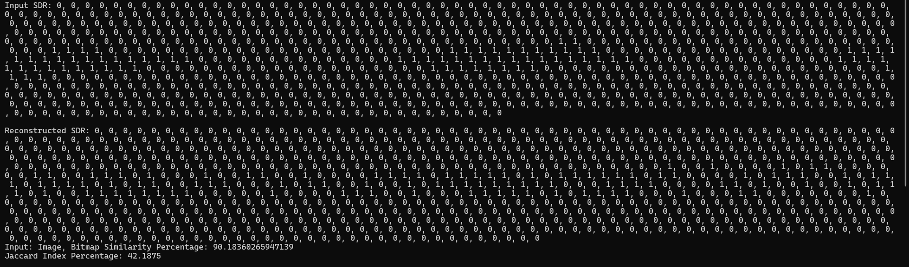
Results
Case 2 : SDR reconstruction for a single image:
MNIST dataset subset (digit 1) underwent learning in SP, yielding SDRs. Upon reconstruction, the original and reconstructed SDRs are compared using Jaccard Index

Slide 13
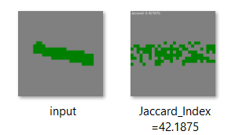
Results
Case -2 :
Upon creating bitmaps for the input SDR and the Reconstructed SDR, it was observed that we were able to achieve a similarity (Jaccard Index Percentage) of 42% (approx).

Slide 14

Future Scope
Batch image processing can be implemented.
Improving the accuracy of the reconstructed images.
The SP can be trained using images of different dimensions, color gradients and filters for a robust training.
The UI can be improved with the goal of providing a more user friendly experience while performing the experiment.

Slide 15


